Slide 1
Photo Album
Accountancy Showcase 2015

Slide 5
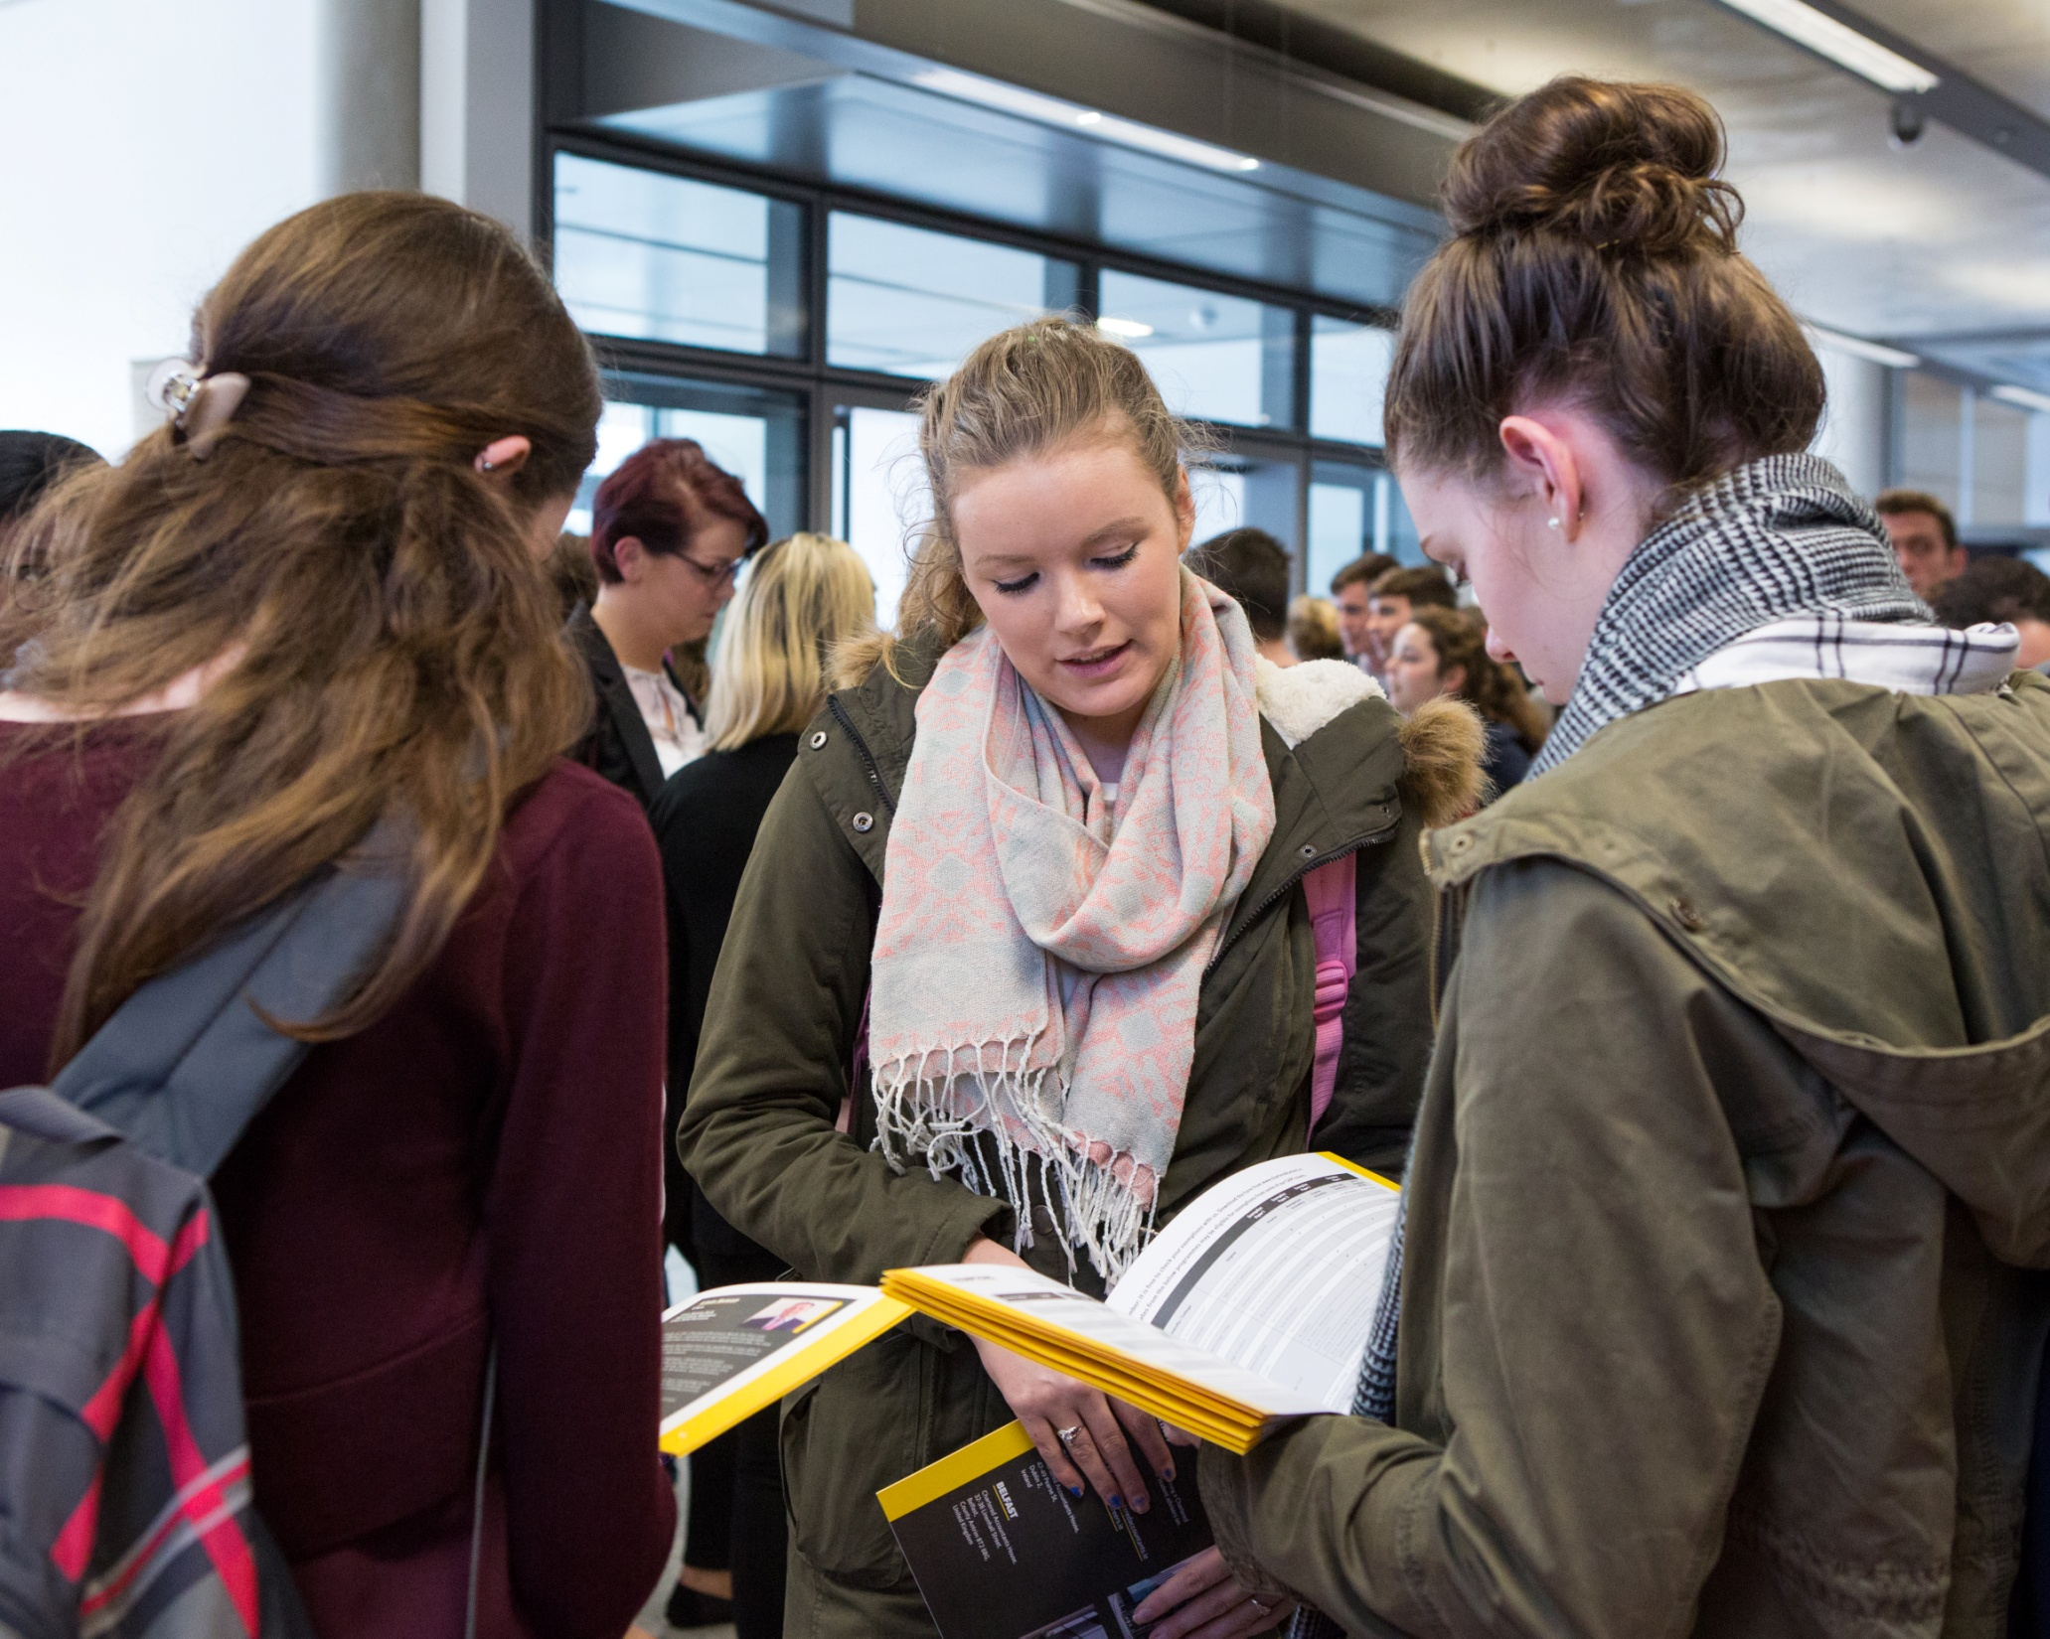

Slide 12
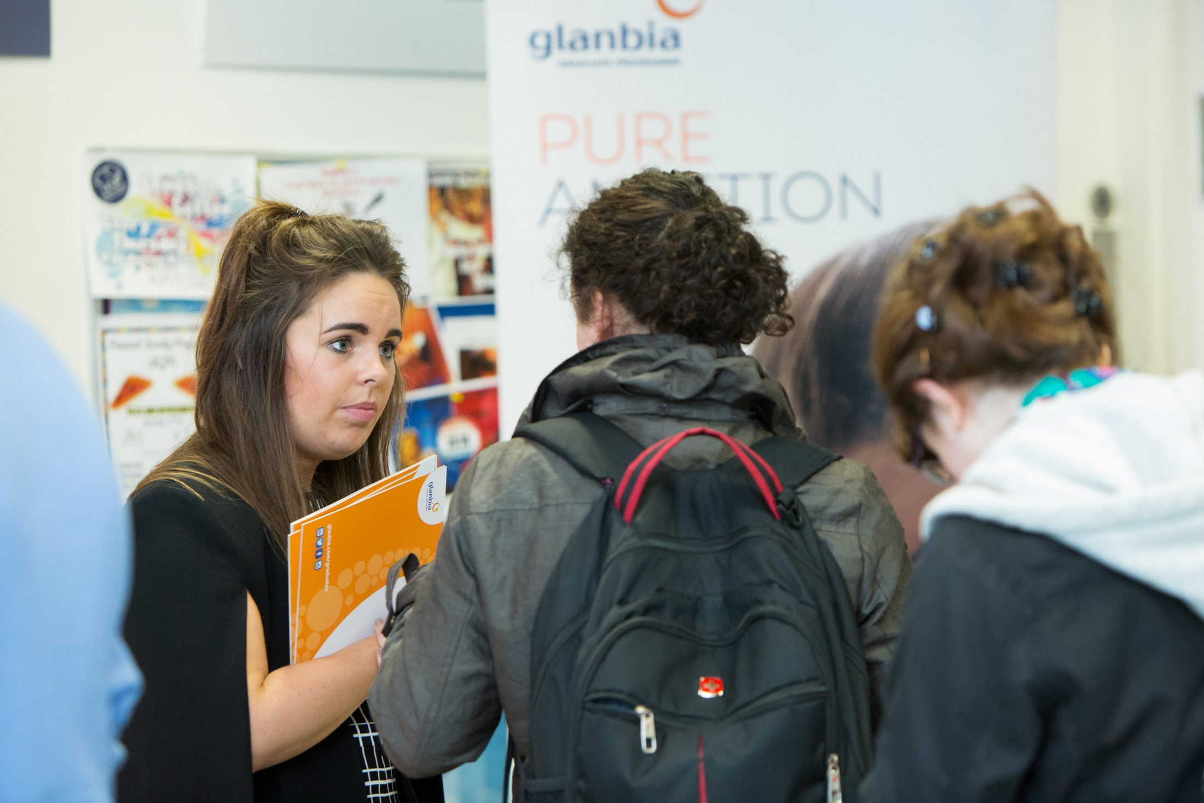

Slide 17
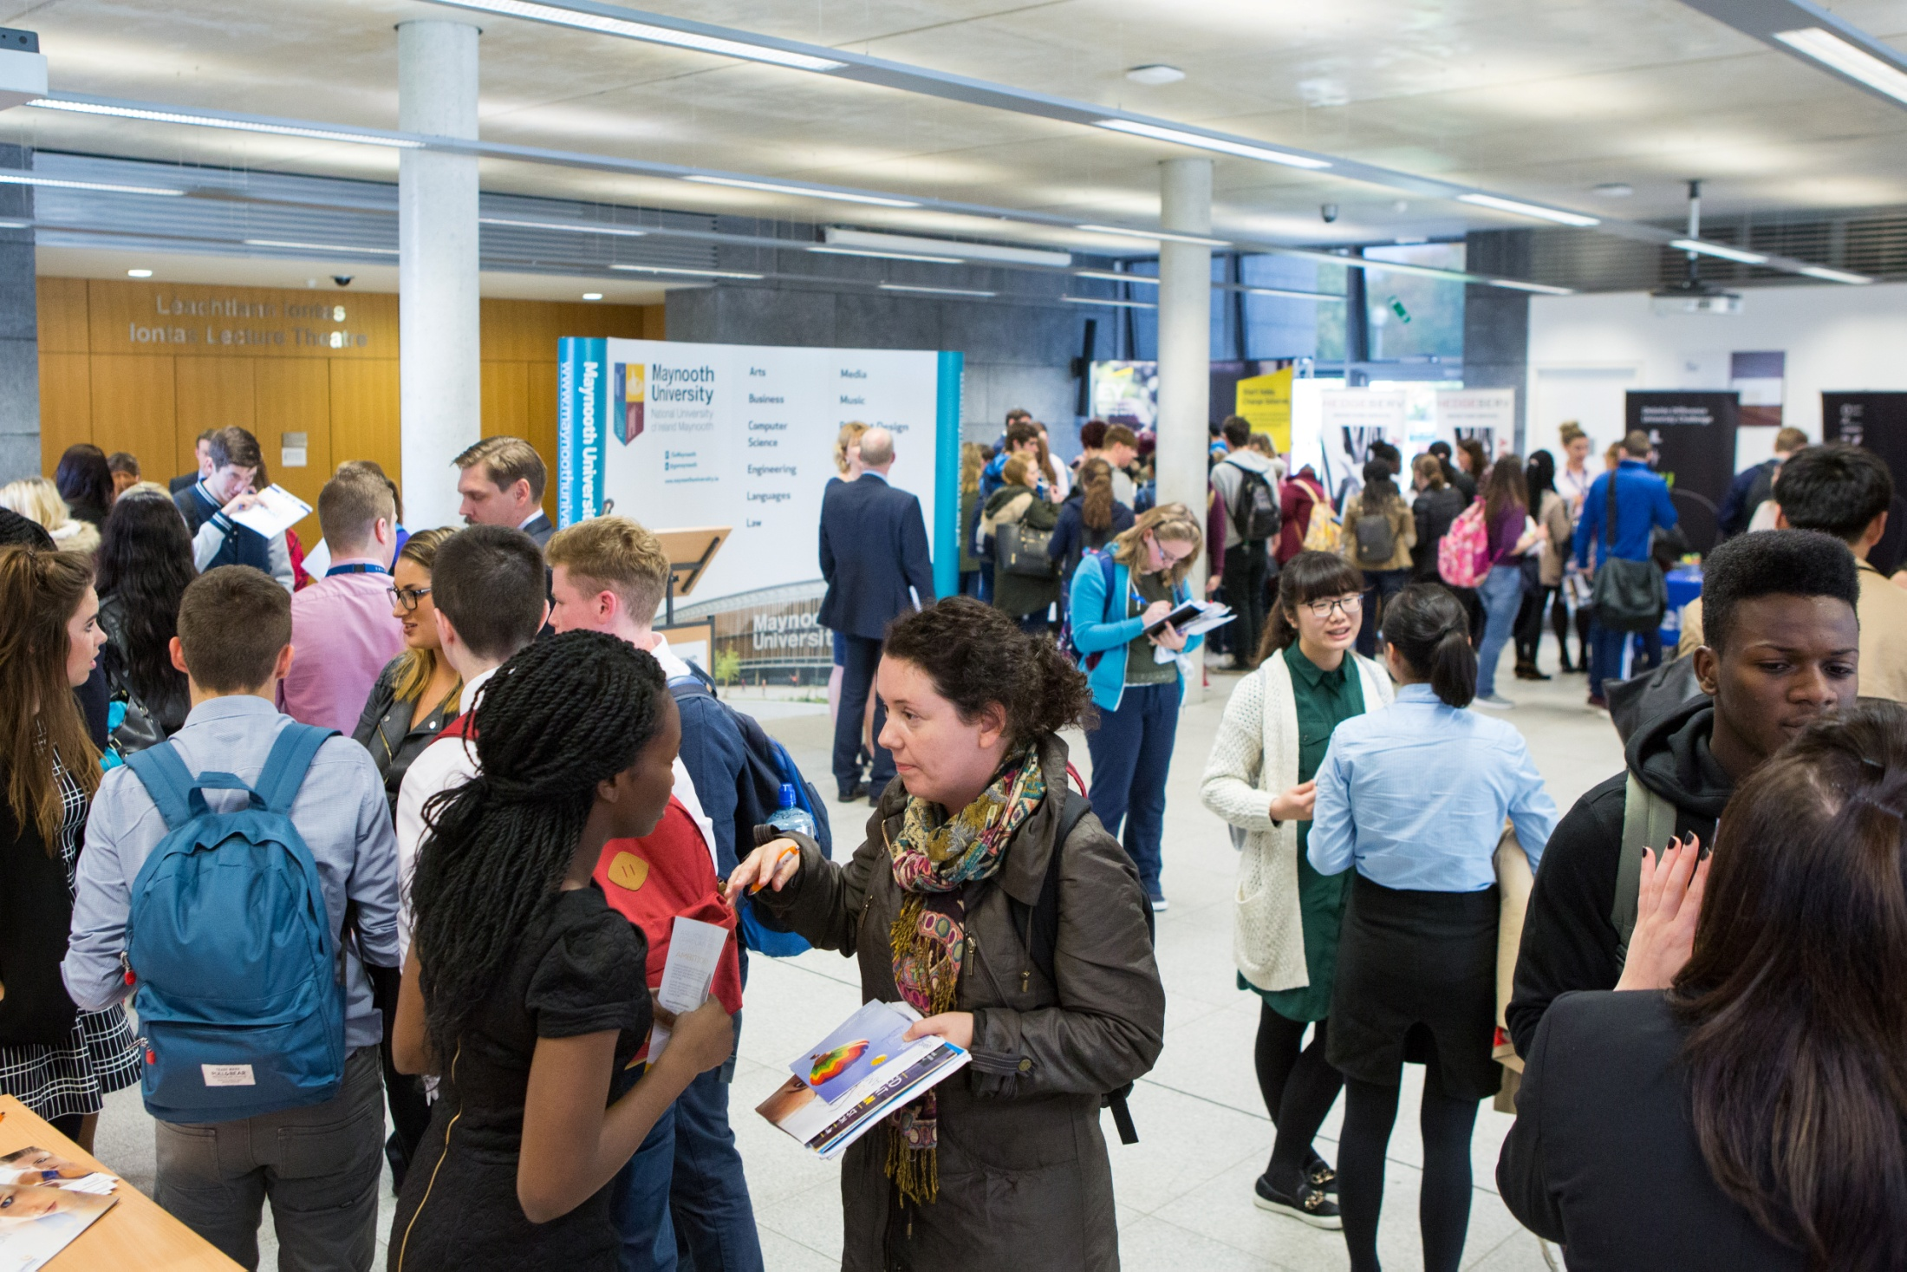

Slide 33
